Slide 1

Understanding ER Model
Department of Computer Engineering and Applications

Slide 2
Agenda
Case Study – College Database
Case Study – University Database

Slide 3

Case Study – ER Model For a college DB
Assumptions :
A college contains many departments
Each department can offer any number of courses
Many instructors can work in a department
An instructor can work only in one department
For each department there is a Head
An instructor can be head of only one department
Each instructor can take any number of courses
A course can be taken by only one instructor
A student can enroll for any number of courses
Each course can have any number of students

Slide 4
Steps in ER Modeling
Identify the Entities
Find relationships
Identify the key attributes for every Entity
Identify other relevant attributes
Draw complete E-R diagram with all attributes including Primary Key
Review your results with your Business users

Slide 5
Steps in ER Modeling
Step 1: Identify the Entities
DEPARTMENT
STUDENT
COURSE
INSTRUCTOR

Slide 6
Entities
DEPARTMENT NAME
LOCATION
DEPARTMENT
STUDENT
STUDENT#
STUDENT NAME
DATE OF BIRTH

Slide 7
COURSE
PRE REQUISITE
COURSE#
COURSE NAME
DURATION
INSTRUCTOR
INSTRUCTOR NAME
TELEPHONE#
ROOM#

Slide 8
Steps in ER Modeling
Step 2: Find the relationships
One course is enrolled by multiple students and one student enrolls for multiple courses, hence the cardinality between course and student is Many to Many.
The department offers many courses and each course belongs to only one department, hence the cardinality between department and course is One to Many.
One department has multiple instructors and one instructor belongs to one and only one department , hence the cardinality between department and instructor is one to Many.
Each department there is a “Head of department” and one instructor is “Head of department “,hence the cardinality is one to one .
One course is taught by only one instructor, but the instructor teaches many courses, hence the cardinality between course and instructor is many to one.

Slide 9
Steps in ER Modeling
Step 3: Identify the key attributes
Deptname is the key attribute for the Entity “Department”, as it identifies the
Department uniquely.
Course# (CourseId) is the key attribute for “Course” Entity.
Student# (Student Number) is the key attribute for “Student” Entity.
Instructor Name is the key attribute for “Instructor” Entity.
Step 4: Identify other relevant attributes
For the department entity, the relevant attribute is location
For course entity, course name,duration,prerequisite
For instructor entity, room#, telephone#
For student entity, student name, date of birth

Slide 10
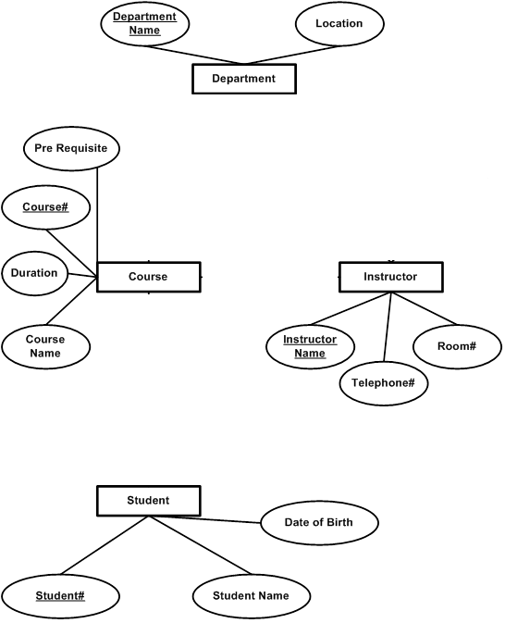

Slide 11
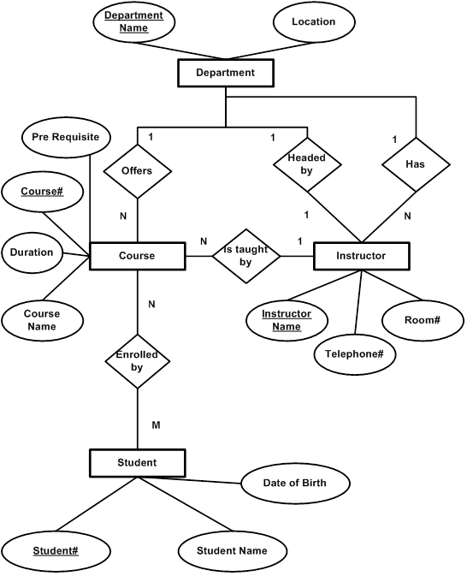

Slide 13
Designing an ER Diagram
Consider the following set of requirements for a University database. Design an ER diagram for this application:
The university keeps track of each student's name, student number, social security number, current address and phone number, permanent address and phone number, birthdate, sex, class (freshman, graduate), major department, minor department (if any), degree program (B.A., B.S., ... Ph.D.). Some user applications need to refer to the city, state, and zip code of the student's permanent address and to the student's last name. Both social security number and student number are unique for each student. All students will have at least a major department.
Each department is described by a name, department code, office number, office phone, and college. Both the name and code have unique values for each department.
Each course has a course name, description, course number, number of credits, level and offering department. The course number is unique for each course.
Each section has an instructor, semester, year, course, and section number. The section number distinguishes sections of the same course that are taught during the same semester/year; its value is an integer (1, 2, 3, ... up to the number of sections taught during each semester).
A grade report must be generated for each student that lists the section, letter grade, and numeric grade (0,1,2,3, or 4) for each student and calculates his or her average GPA.

Slide 14
University ER Diagram
Degree
Major In
DName
DCode
OfficeNumber
Name
StudentID
SSN
Birth date
Department
OfficePhone
Sex
Student
Minor In
College
Class
Address
Offer
City
State
Zip
Grade_Report
CName
CourseDesc
Letter Grade
Instructor
Year
Course
GPA
CNumber
Belong_To
Credits
Numeric Grade
Section
SectionNumber
Semester

Slide 15
Thank You

